Slide 1
Project 1 Classification on Wineinformatics Data
Dr. Bernard Chen Ph.D.
Troy University

Slide 2
Objective:
Implement classification algorithm in coding form
Familiar with a real world data as input dataset
Simulate a research environment

Slide 3
Knowledge Discovery (KDD) Process
Knowledge
Pattern Evaluation
  Data mining—core of knowledge discovery process
Data Mining
Task-relevant Data
Data Warehouse
Selection
Data Cleaning
Data Integration
Databases

Slide 4
Dataset
You are provided two datasets:
  Training Dataset
  Testing dataset
Introduction to Wineinformatics

Slide 5
Introduction
Wine was considered as a luxury in old days; yet, it is more and more popular and enjoyed by a wide variety of people today.
The quality of the wine is usually assured by the wine certification, which is generally assessed by physicochemical and sensory tests.

Slide 6
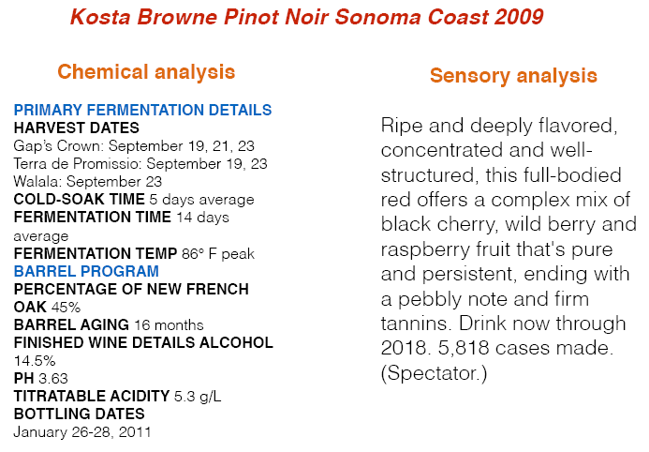
physicochemical v.s. sensory tests

Slide 7
Computational Wine Wheel
Data Source: Wine Spectator
  16,000 reviews per year, 300,000 reviews in the database
For each reviewed wine, a rating within a 100-points scale is given to reflect how highly their reviewers regard each wine relative to other wines in its category and potential quality.
  95-100 Classic: a great wine
  90-94 Outstanding: a wine of superior character and style
  85-89 Very good: a wine with special qualities
  80-84 Good: a solid, well-made wine
  75-79 Mediocre: a drinkable wine that may have minor flows
  50-74 Not recommended

Slide 8
sensory tests
Wine sensory reviews consist of the score summarizes a wine’s overall quality and the testing note describes the wine’s style and character.
Dow’s Vintage Port 2011 100pts
Powerful, refined and luscious, with a surplus of dark plum, kirsch and cassis flavors that are unctuous and long. Shows plenty of grip, presenting a long, full finish, filled with Asian spice and raspberry tart accents. Rich and chocolaty. One for the ages. Best from 2030 through 2060.

Slide 9
sensory tests
Wine sensory reviews consist of the score summarizes a wine’s overall quality and the testing note describes the wine’s style and character.
Dow’s Vintage Port 2011 100pts
Powerful, refined and luscious, with a surplus of dark plum, kirsch and cassis flavors that are unctuous and long. Shows plenty of grip, presenting a long, full finish, filled with Asian spice and raspberry tart accents. Rich and chocolaty. One for the ages. Best from 2030 through 2060.

Slide 10
sensory tests
Wine sensory reviews consist of the score summarizes a wine’s overall quality and the testing note describes the wine’s style and character.
Dow’s Vintage Port 2011 100pts
Powerful, refined and luscious, with a surplus of dark plum, kirsch and cassis flavors that are unctuous and long. Shows plenty of grip, presenting a long, full finish, filled with Asian spice and raspberry tart accents. Rich and chocolaty. One for the ages. Best from 2030 through 2060.

Slide 11
Wine Flavor Categories in the “Computaional Wine Wheel”
“Category 1” is non-flavor descriptions (PURE, BEAUTY, WONDERFUL, etc.).
“Category 2” is the non-flavor wine characteristics (TANNINS, ACIDITY, BODY, etc.).
“Category 3” is the food and wine flavor characteristics (specific fruit, woods, flavors, etc.).

Slide 12
Introduction
Once the attributes can be extracted from wine sensory reviews, the next question is how to mine unique patterns and information to benefit the society including wine producers, distributors and consumers.
“What makes wine achieve a 90+ rating?”
“What are the shared similarities amongst groups of wine and what is the suggested food paring?”
“What characteristics differ between wines from Bordeaux, France and Napa, United States?”
“What is the weather impact on the wine growing process?”

Slide 13
Computational Wine Wheel 2.0
Wine Spectator selects the Top 100 wines based on quality, value, availability and an “X-factor”.
We collected past 10 years top 100 wines and compose our Computational Wine Wheel 2.0
When looking at our finished list, we noticed many cases where groups of attributes were really just permeations of the same thing.
  FRESHLY-CUT APPLE, RIPE APPLE, and APPLE => Apple
  GREEN APPLE => Green Apple

Slide 14
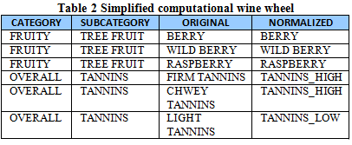
Computational Wine Wheel Example- two words scan
Kosta Browne Pinot Noir Sonoma Coast 2009 95pts
Ripe and deeply flavored, concentrated and well-structured, this full-bodied red offers a complex mix of black cherry, wild berry and raspberry fruit that's pure and persistent, ending with a pebbly note and firm tannins.

Slide 15
Computational Wine Wheel Example- one word scan
Kosta Browne Pinot Noir Sonoma Coast 2009 95pts
Ripe and deeply flavored, concentrated and well-structured, this full-bodied red offers a complex mix of black cherry, wild berry and raspberry fruit that's pure and persistent, ending with a pebbly note and firm tannins.

Slide 16

Computational Wine Wheel Example
Kosta Browne Pinot Noir Sonoma Coast 2009 95pts
Ripe and deeply flavored, concentrated and well-structured, this full-bodied red offers a complex mix of black cherry, wild berry and raspberry fruit that's pure and persistent, ending with a pebbly note and firm tannins.

Slide 17
Data
So let us take a look of the given dataset for your project

Slide 18
Requirements:
Part1
Please implement one of the classification algorithms introduced in the class (Decision Forest, Naïve Bayes or KNN) in any programming language your team chooses. Perform the prediction of whether a wine can achieve 90+ based on their sensory reviews. Apply the chosen algorithm on the training dataset and predict the label for the testing dataset given in the project.

Slide 19
Requirements:
Part2.
Compare the predicted result with the true label in the testing dataset. Calculate the prediction accuracy (#corrected predicted wine/#total wine in testing dataset)

Slide 20
Requirements:
Part3.
Implement SVM using SVM light on the training dataset and make predictions on the testing dataset. The SVM topic will be discussed in the next class. Also calculate the prediction accuracy and compare with part2.

Slide 21
Requirements:
Due day: Given in the Canvas
I will arrange online meetings using online support link with each team. I will take a look your program and the prediction results. We will discuss your results and have one more step of programming/improvement/discussion as follow up project (Due one week after the due day). Please prepare your testing dataset in the format of:
Real grade Predicted grade
1 1
1 1
1 0
0 0
0 1
…

Slide 22
Requirements:
Please prepare your testing dataset in the format of:
___________________________________
Real grade Predicted grade
1 1
1 1
1 0
0 0
0 1
…
__________________________________

